Slide 1
Object Detection Model using YOLOv4
-Renu Prasad (160121771031)
-Abhiram (160121771032)

Slide 2
Table of Contents
1. Introduction.
2. Problem Statement.
3. Objective
4. Overview.
5. Packages and Algorithms.
6. Project Description.
7. Result.
8. Conclusion.

Slide 3
Introduction
Today, we will explore the fascinating world of object detection using YOLOv4, a cutting-edge deep learning algorithm.
Object detection is vital in computer vision, autonomous vehicles, surveillance, and robotics. It enhances image recognition, enables safe navigation, and improves security systems. Robots equipped with object detection perform complex tasks. It empowers machines to understand visual data, extract information, and make intelligent decisions, revolutionizing various industries.

Slide 4
Problem Statement Real-Time Object Detection: Enhancing Visual Understanding and Safety

Slide 5
Objective
This project aims to address the limitations of traditional approaches by implementing the YOLOv4 (You Only Look Once) object detection algorithm. By leveraging the power of YOLOv4, we seek to develop a real-time object detection system capable of accurately identifying and localizing objects in video streams or live camera feeds.

Slide 6
Overview
Loading the pre-trained YOLOv4 model with the associated weights and configuration files.
Initializing the camera or loading a video file for real-time object detection.
Performing object detection on each frame using the YOLOv4 model.
Displaying the detected objects on the frame with bounding boxes and class labels.

Slide 7
Packages and Algorithms
1. OpenCV
1. YOLOv4
OpenCV2 is a widely-used open-source computer vision library. It offers a comprehensive set of functions and algorithms for image and video processing, object detection, facial recognition, and more, empowering developers to build robust computer vision applications.
YOLOv4 (You Only Look Once version 4) is an advanced object detection algorithm that combines high accuracy and real-time performance. It leverages deep neural networks and innovative architectural enhancements to achieve state-of-the-art object detection capabilities, making it suitable for a wide range of applications.

Slide 8
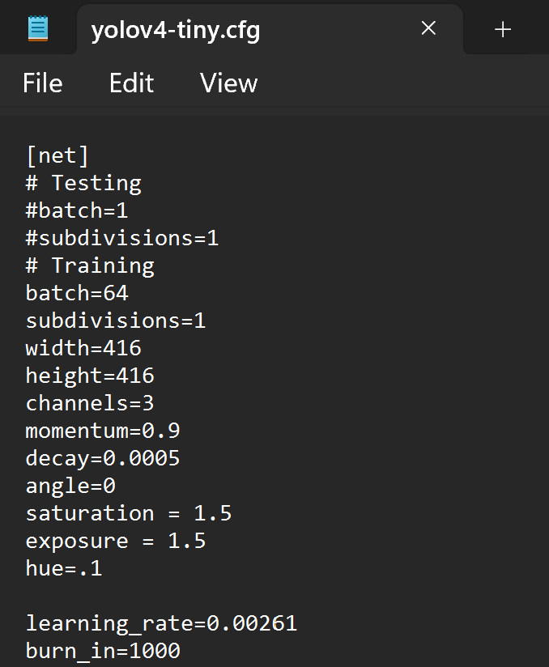
Project Description.
Segment 1. Model and Configuration Loading
Loading the YOLOv4 pre-trained weights and configuration files using the ‘cv2.dnn.readNet’ function.

Slide 9
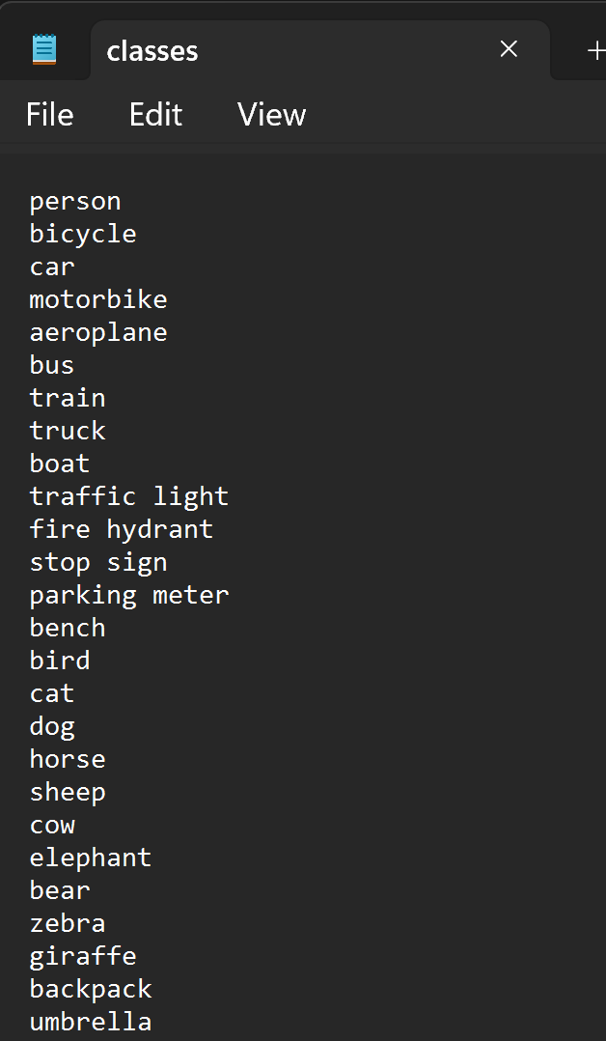
Segment 2. Class List Loading
Loading the dnn_model/classes.txt for the class names that we stored as per the index for detecting the name of the objects pretrained according to the dnn_model.

Slide 10
Segment 3. Camera/ Video file Initialization
Initializing the camera or video feed using the ‘cv2.VideoCapture()’ function.
We use ’ cv2.VideoCapture(0)’ for initializing the VideoCamera

Slide 11
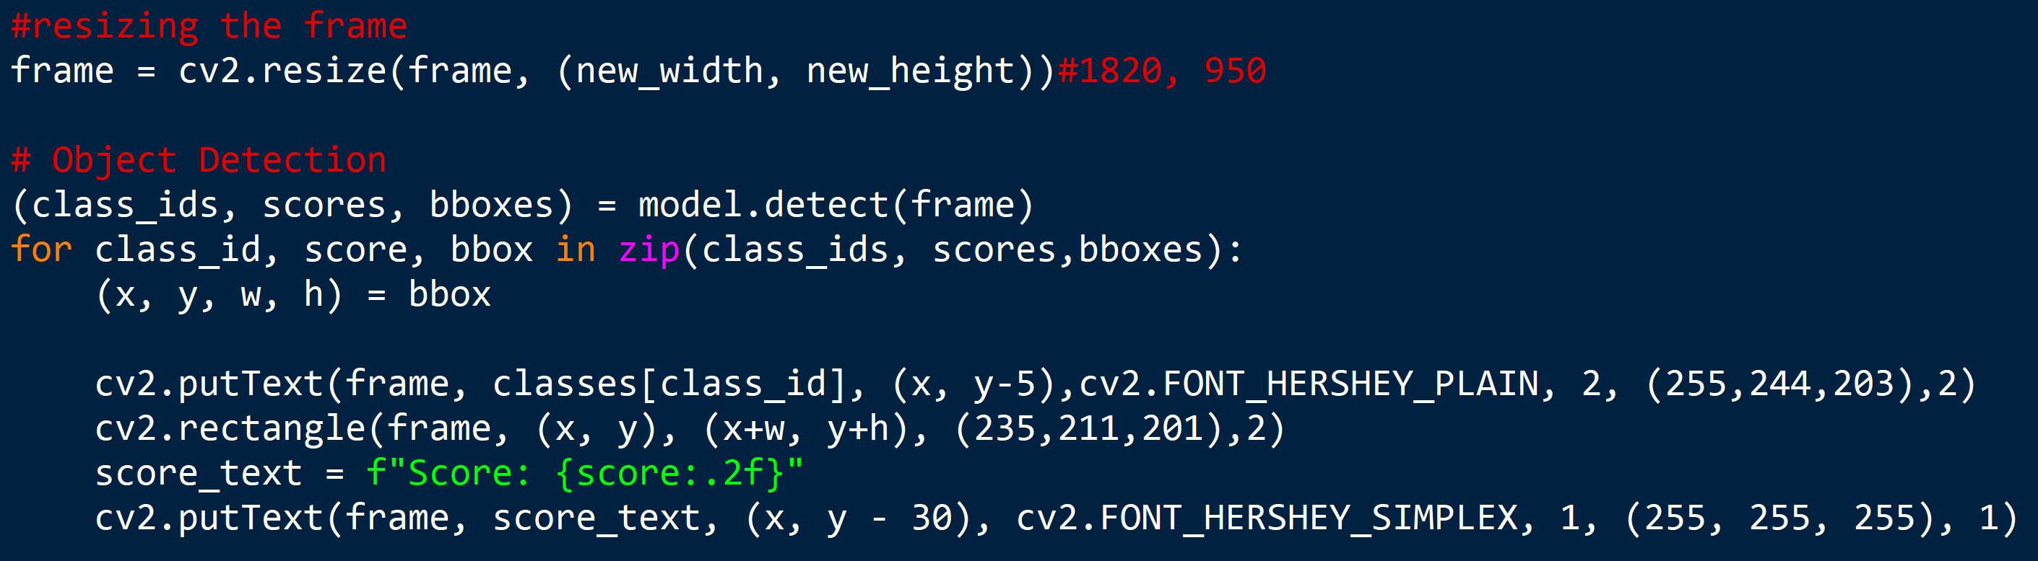
Segment 4. Object Detection and Annotation
Detecting the objects for each frame in a ‘while’ loop.
Returned “classID’s, Bounding Boxes, Scores” will be displayed on each frame according to the co-ordinates returned by the model from Bounding Boxes.
Showing the frames with customized delay between frames.(generally 1ms)

Slide 12
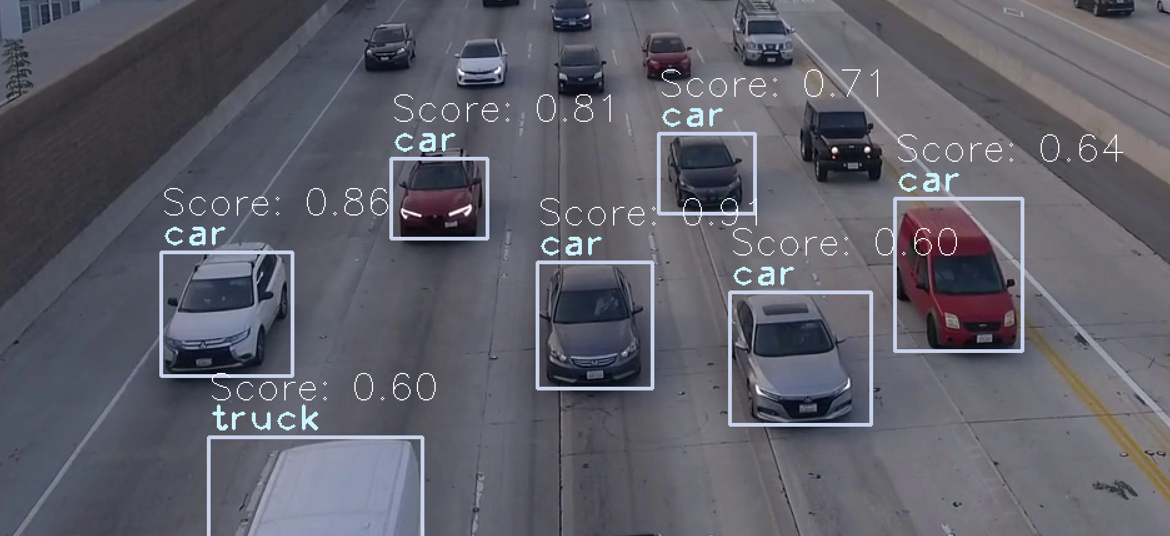
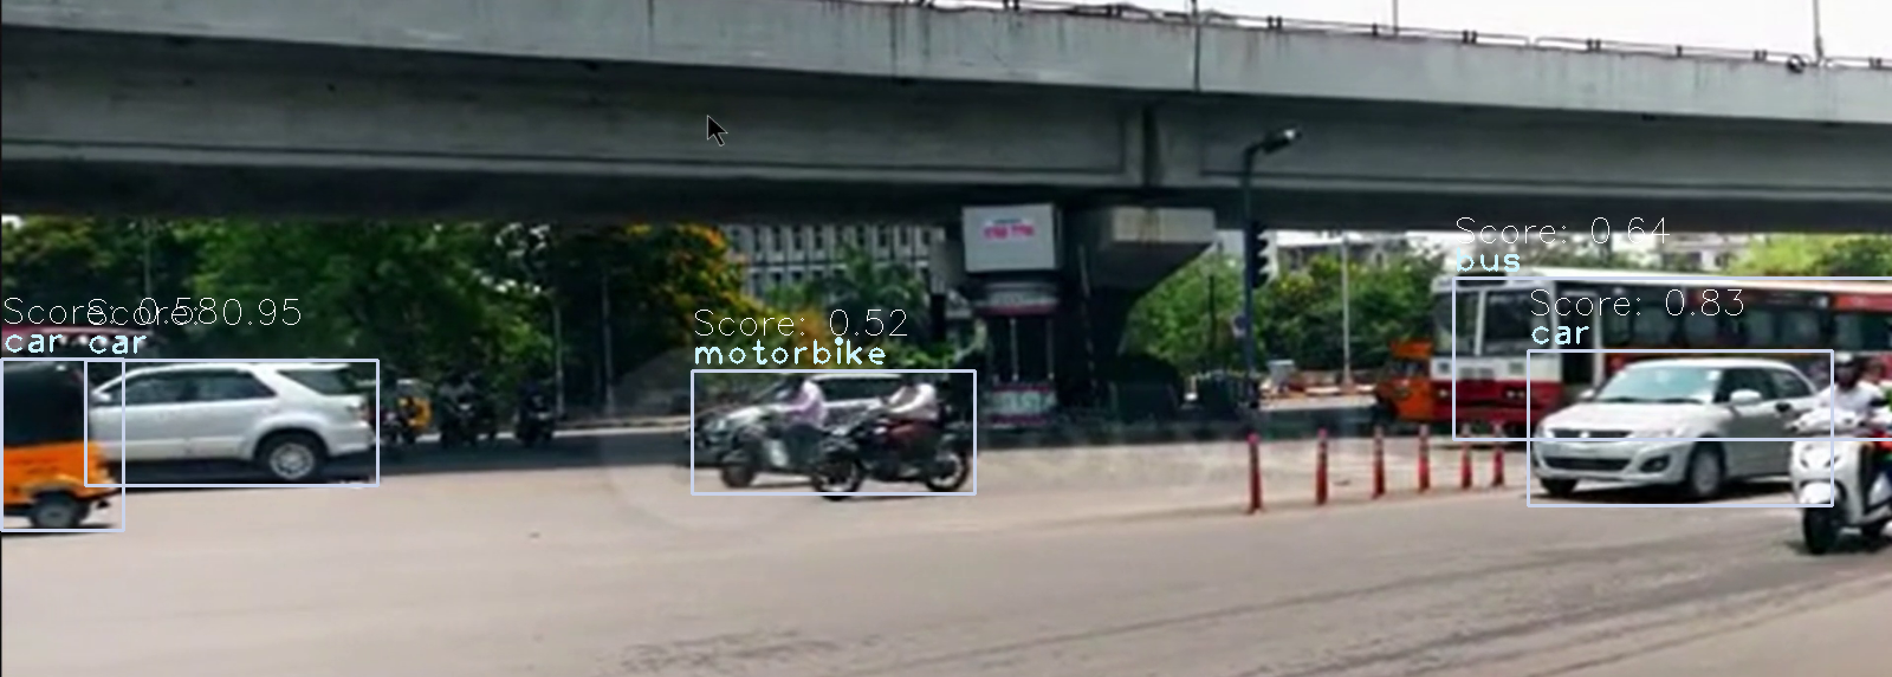
Results

Slide 13
Conclusion
In conclusion, our project successfully implemented a real-time object detection system using the powerful YOLOv4 algorithm and OpenCV's DNN module. By accurately detecting and localizing objects in live camera feeds, we have demonstrated the effectiveness and practicality of real-time object detection for diverse applications. This project opens up possibilities for enhanced visual understanding, safety, and automation in domains such as surveillance, robotics, and autonomous systems.

